Slide 1
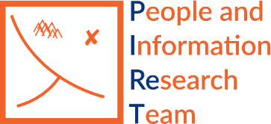

Ethics in Machine Learning
Michael D. Ekstrand
December 3, 2020

Slide 2

Machine Learning for Evil

Slide 3
Sample of Ethical Issues
Is the data collected ethically?
Does the output discriminate?
Is the system intended to harm?
Can the system be misused to harm?
Does it perpetuate harmful stereotypes?
Who receives benefit?
Who pays costs?

Slide 4
ACM Code of Ethics §1 General Ethical Principles
A computing professional should ….
Contribute to society and to human well-being, acknowledging that all people are stakeholders in computing.
Avoid harm.
Be honest and trustworthy.
Be fair and take action not to discriminate.
Respect the work required to produce new ideas, inventions, creative works, and computing artifacts.
Respect privacy.
Honor confidentiality.
Notes:
There are many different ways of taxonomizing this work. I’ll start with 3.
I’ll be discussing how to work out these principles in recommender systems, especially 1, 2, and 4.
Will also touch on privacy.

Slide 5
Principles of Human Subjects Ethics
Respect for Persons
Individuals should be treated as autonomous agents
Persons with diminished autonomy are entitled to protection
Beneficence
Avoid harm, provide benefit
Justice
How are costs and benefits of research distributed?
See the Belmont Report

Slide 6
When Should You Think About Ethics?

Slide 7
Considering Ethics
Task Definition
Purpose
Impact
Objective Function
Data Collection
Evaluation
Does evaluation reflect stakeholder impact?
Are costs, benefits, impacts fairly distributed?

Slide 8


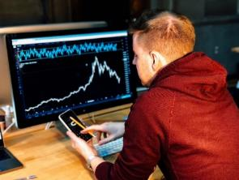

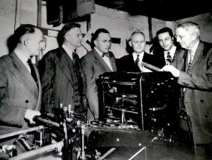
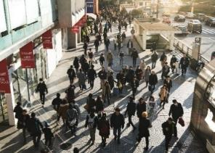
Considering Stakeholders
Must identify stakeholders to reason about impact

Slide 9
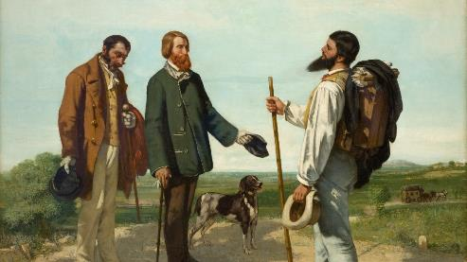
Algorithmic Realism [Green and Viljoen 2020]
Bonjour, Monsieur Courbet. Gustave Corbet, 1854.
Formalism studies theoretical properties
Realism studies application, practice, and contextual outcomes
Need to study what the system actually does, not just theoretically should do
Notes:
Green, B., and S. Viljoen. 2020. “Algorithmic Realism: Expanding the Boundaries of Algorithmic Thought.” In Proceedings of the 2020 Conference on Fairness, Accountability, and Transparency. benzevgreen.com. https://doi.org/10.1145/3351095.3372840.

Slide 10

Q: Is This An Ethical Task?

Slide 11
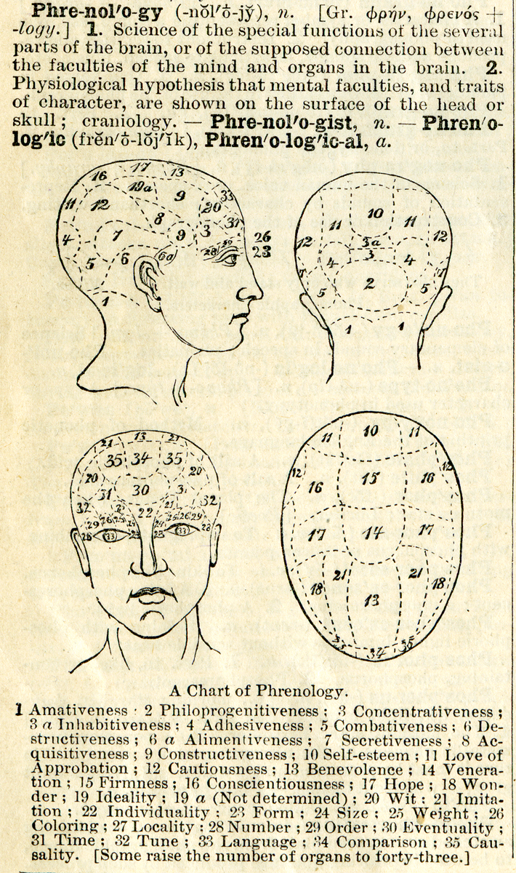
Q: Is This A Sensical Task?
Does trying to predict Y from X make any sense?
Is it a category error?
What does it assume about X, Y, and their relationship?
Facial crime prediction:
Assumes crime is an intrinsic trait rather than an action or behavior
Assumes crime is appropriately labeled

Slide 12
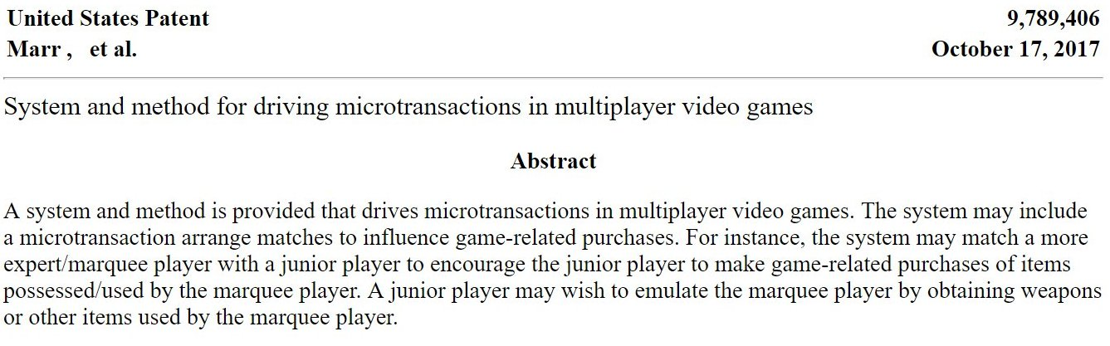
Q: Is This An Ethical Goal?
Fundamental task: matchmaking — no problems there
Matchmaking objective: get people to buy more stuff by making them lose
Notes:
Barabas, C., Virza, M., Dinakar, K., Ito, J., & Zittrain, J. (2018). Interventions over Predictions: Reframing the Ethical Debate for Actuarial Risk Assessment. In S. A. Friedler & C. Wilson (Eds.), Proceedings of the 1st Conference on Fairness, Accountability and Transparency (Vol. 81, pp. 62–76). PMLR.

Slide 13
Action: Assess Task Ethics
Make sure the task is ethical
Make sure the objective is appropriate
Once you have an ethical task, we can think about next steps
Data
Evaluation
Monitoring

Slide 14
Q: Is This Data Ethically Collected?
Where did it come from?
Is there appropriate consent?
Is it properly de-identified if necessary?
Sampling strategy - who is included in the data?
Response bias - who responds / submits data points?

Slide 15

Informed Consent
Research subjects should
Be informed about the research
In terms they can understand
So they can voluntarily choose whether to participate
Photo by Philipp Wüthrich on Unsplash

Slide 16
Q: Is This Data Responsibly Coded?
How is the data recorded?
Who decided the codebook?
Does data encoding respect the human subjects?
Do people have a right to inspect or correct their data?
Required under EU GDPR

Slide 17
Critical Theory of Labels
Many labels are social constructs
Does not mean they are not real
Does mean that their meaning & application is socially determined
Is this a reasonable label to apply?
Who gets to apply the label?
What are the criteria for applying the label
Applying the label enacts the label
Labels can have biased meaning or correlation
E.g. 1: crime labels – what is a crime? Who gets labeled criminal?
E.g. 2: ethnic categories – what are the labels? Who decided?

Slide 18
How Do We Label?
Self-description
Expert (or lay) observation
Inference
Facial recognition is biased [Buolamwini & Gebru, 2018]
Gender recognition is problematic [Hamidi, Scheuerman, & Branham, 2018]
Notes:
Buolamwini, J., & Gebru, T. (2018). Gender Shades: Intersectional Accuracy Disparities in Commercial Gender Classification. Proceedings of the 1st Conference on Fairness, Accountability, and Transparency, 81, 77–91.
Hamidi, F., Scheuerman, M. K., & Branham, S. M. (2018). Gender Recognition or Gender Reductionism?: The Social Implications of Embedded Gender Recognition Systems. Proceedings of the 2018 CHI Conference on Human Factors in Computing Systems, 8.

Slide 19
Types of Harms Crawford nips 2017 keynote
Distributive Harms
Representative Harms
Am I harmed by how results or outputs are distributed?
Disproportionally not recommended
Disproportionally misclassified
Lower quality of service
Am I harmed by how the system represents me to itself or others?
Misgendering
Negatively stereotyped
Notes:
Crawford, Kate. 2017. “The Trouble with Bias.” Presented at the Neural Information Processing Systems, December 5. https://youtu.be/fMym_BKWQzk.

Slide 20
Types of Data Problems
Sampling bias
Response bias
Measurement variance
Incorrect data coding
Mismatch between data and goal

Slide 21
Q: Does Data Match Goal?
Does our ground truth match our prediction target?
Do our predictor features measure what they claim?
E.g. Cathy O’Neil (Twitter, Oct. 5, 2020):
I will maintain that we do not have crime data, only arrest data and reported crime data, and no sophisticated mathematical techniques can make up for that.
Ultimately we only predict police, not crime. And police are pretty predictable.
Notes:
https://twitter.com/mathbabedotorg/status/1313087130214825985

Slide 22
Q: Does It Work?
Robust, rigorous evaluation
Inappropriate evaluation means you don’t understand effectiveness
Can incorrectly weigh costs and benefits
Requires that data match goal first!

Slide 23
Q: Does It Work for All People?
Does it work for
All users
All groups of users
Some users better than others
How are its effects distributed?

Slide 24
Pivot: Aggregates to Fairness
Aggregate Metrics
Fairness
Utility
Accuracy
Who gets (how much) utility?
Is it equitably distributed?
Accurate (or not) for who?
Can be individual or group-based

Slide 25
What is fair?
Individual Fairness
Group Fairness
Do I get treated in accordance with my merit?
Does my group get treated comparably to other groups?
Often incompatible [Friedler, Scheidegger, and Venkatasubramanian, 2016]
Notes:
Friedler, Sorelle A., Carlos Scheidegger, and Suresh Venkatasubramanian. 2016. “On the (im)possibility of Fairness.” arXiv:1609.07236 [cs, Stat], September. http://arxiv.org/abs/1609.07236.

Slide 26
Defining (Group) (Un)Fairness
Disparate Treatment
Explicitly treat one group differently from another
Disparate Impact
Decisions systematically impact one group more than another
Example: fraud detector claims higher likelihood of fraud for one ethnic group
Disparate Mistreatment
One group systematically experiences more error than another
Example: fraud detector erroneously finds fraud more frequently for one group
Notes:
Mitchell, Shira, Eric Potash, Solon Barocas, Alexander D’Amour, and Kristian Lum. 2018. “Prediction-Based Decisions and Fairness: A Catalogue of Choices, Assumptions, and Definitions.” arXiv [stat.AP]. arXiv. http://arxiv.org/abs/1811.07867.

Slide 27
Where does Bias Come From? [Ekstrand et al. SIGIR 2019 tutorial]
World
Source
Data
Model and
Training
Evaluation
Results

Slide 28
Unfairness in the world
Different group sizes
Naive modeling learns more accurate predictions for majority group
Historical and ongoing discrimination
Produces ‘unnatural’ distributions, e.g. redlining in the U.S. skews location, housing
Oppression skews social position, socioeconomic status, education, etc.
Arises from policy, practice, or both
Effects propagate after official practice ends

Slide 29
Unfairness in models
Using sensitive information (e.g. race) directly + adversely
Algorithm optimization eliminates “noise”, which might constitute the signal for some groups of users
Unfairness is usually an emergent property of data + model.

Slide 30
Unfairness in evaluations
Definition of Success - who is it good for, and how is that measured?
Who decided this? To whom are they accountable?
How are relevant subgroups measured and aggregated in evaluation?
All the data issues apply

Slide 31
Unfairness in response
Humans + computers do not compose
Does model output skew human response differently?
Social factors can skew response
Community support for loan repayment, making court dates
Response feeds into next round’s training
Affects subsequent data collection too!
Response affects the world (e.g. incarceration rates & distribution, finance access and its effects)

Slide 32
Q: Are Components Appropriate?
Data may be biased
Data suitable for one purpose may not be suitable for antoher
Transfer learning and pre-trained models can embed problems

Slide 33
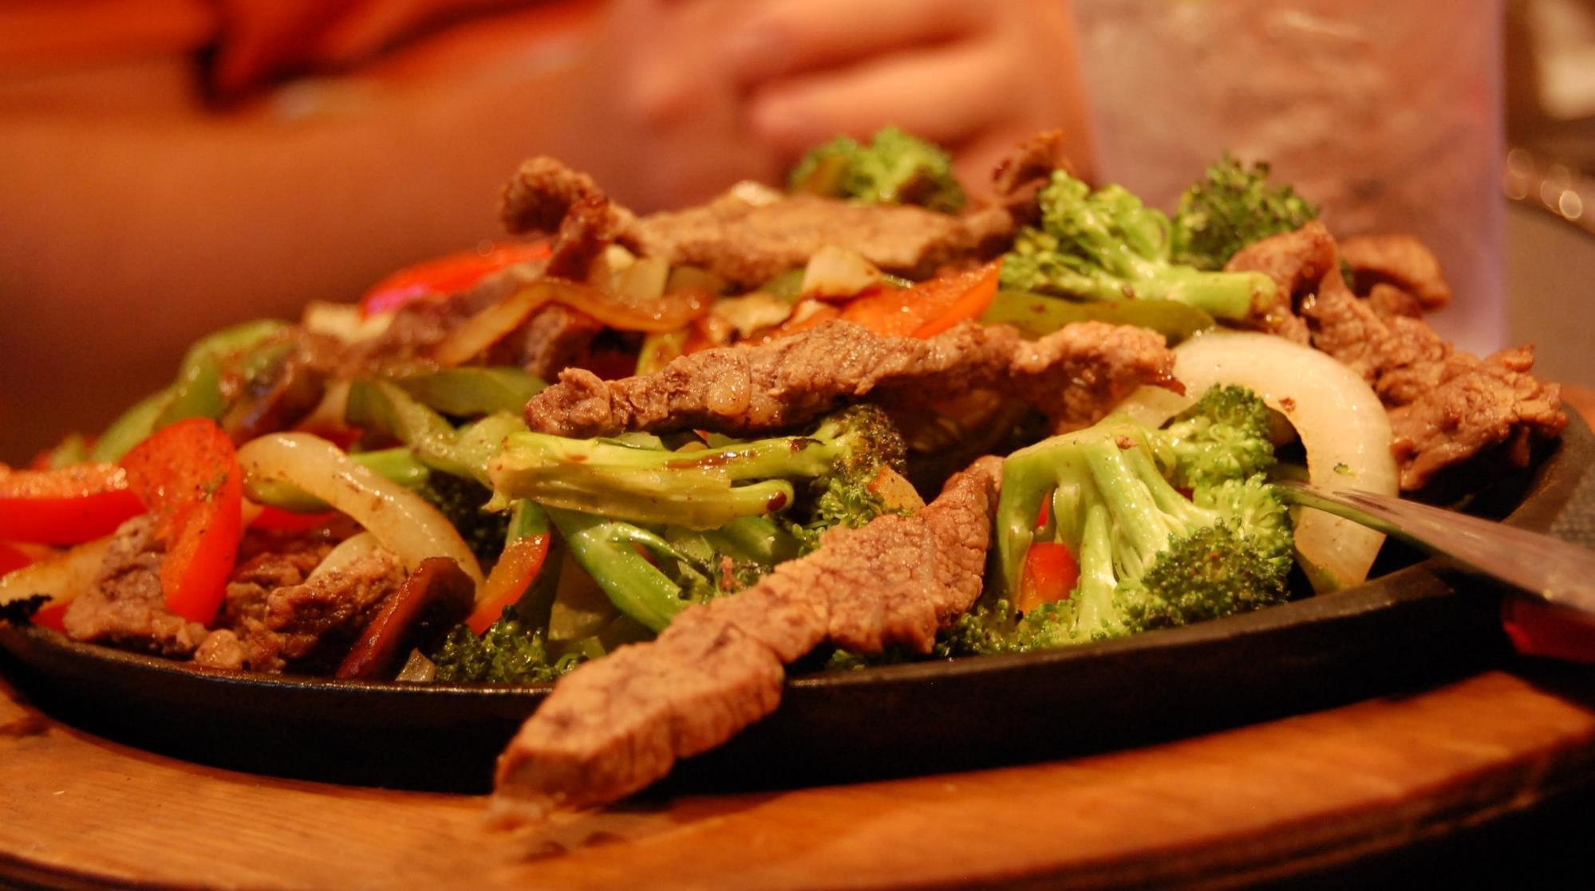
Robyn Speer; https://goo.gl/13Ss1p
Fajitas, by stu_spivack. CC-BY-SA 2.0.

Slide 34
What Happened?
Word embeddings learns word relationships
From use in text
Human-generated text has many relationships
Some of those we might not want…
Derogatory racialized language
Gender stereotypes
Embedding code isn’t racist, but the learned model can be
What happens when using Word2Vec to screen resumes?

Slide 35
Q: What Are The Effects?
Direct effects – what happens when the system is deployed?
E.g.: statistical modeling of loan risk can improve access to credit
Indirect effects – what behaviors does it change/incentivize?

Slide 36
Pitfalls of Ethics
Selbst et al. identify 5 abstraction traps:
Framing - isolating technical components from their surrounding sociotechnical contexts and human response
Portability - assuming equivalence between social contexts
Formalism - assuming operationalizations can fully capture social concepts
Ripple Effect - overlooking changes to the social system that arise from introducing or modifying technology
Solutionism - assuming technology is the best (or even a good) solution
A Selbst, d boyd, S Friedler, S Venkatasubramanian, J Vertesi. Fairness and Abstraction in Sociotechnical Systems. 2019

Slide 37
No Final Answer
There isn’t “an answer” to bias, fairness, or ethics.
Selbst et al., The Formalism Trap:
Failure to account for the full meaning of social concepts such as fairness, which can be procedural, contextual, and contestable, and cannot be resolved through mathematical formalisms
Notes:
Selbst, Andrew D., Danah Boyd, Sorelle A. Friedler, Suresh Venkatasubramanian, and Janet Vertesi. 2019. “Fairness and Abstraction in Sociotechnical Systems.” In Proceedings of the Conference on Fairness, Accountability, and Transparency - FAT* ’19, 59–68. New York, New York, USA: ACM Press.

Slide 38
Regulation in US Federal Funding
Common Rule regulates federally-funded human subjects research
Organizations must have an Institutional Review Board (IRB)
IRB must approve human subjects research
Uses Belmont principles
Reviews consent procedures, analysis, etc.
Weighs risks and benefits
IRB approval does not mean something is ethical.

Slide 39
Human Subjects
U.S. Common Rule:
Human subject means a living individual about whom an investigator (whether professional or student) conducting research:
(i) Obtains information or biospecimens through intervention or interaction with the individual, and uses, studies, or analyzes the information or biospecimens; or
(ii) Obtains, uses, studies, analyzes, or generates identifiable private information or identifiable biospecimens.

Slide 40
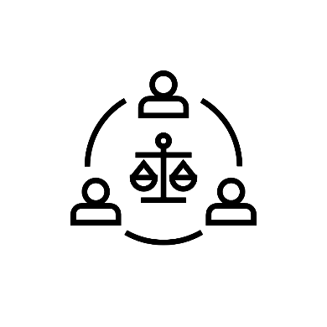

Compliance
Ethics is about doing the right thing
Compliance is about following rules and regulations
Some rules are to enforce a baseline of ethical behavior, but compliance is not ethics.

Slide 41
Takeaways
Look at how impacts are distributed, not just aggregate impact
Are there winners and losers?
Who gets how much benefit?
Identify stakeholders in an application or analysis
What are their impact, ethics, or fairness concerns?
Appreciate the contextual and contestible nature of positive impact
Identify and navigate tradeoffs

Slide 42
What Can We Do?
Always be suspicious
Audit our models and systems
Regularly and proactively
This is becoming required in some jurisdictions!
Look for more/better data
Be cautious of over-surveilling
Question our assumptions

Slide 43

The Real World of Technology
Ursula Franklin’s 1989 Massey Lectures
Technology is not just artifacts.
It is process
It affects people
It was designed by human action
Notes:
Where does my thinking come from? Where does my language come from?

Slide 44
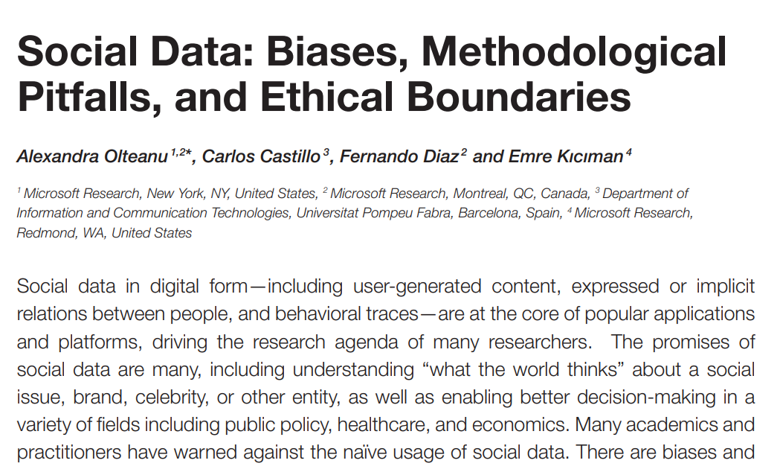
Learning More: Data
Notes:
Olteanu, Alexandra, Carlos Castillo, Fernando Diaz, and Emre Kıcıman. 2019. “Social Data: Biases, Methodological Pitfalls, and Ethical Boundaries.” Frontiers in Big Data 2: 13. https://papers.ssrn.com/abstract=2886526

Slide 45
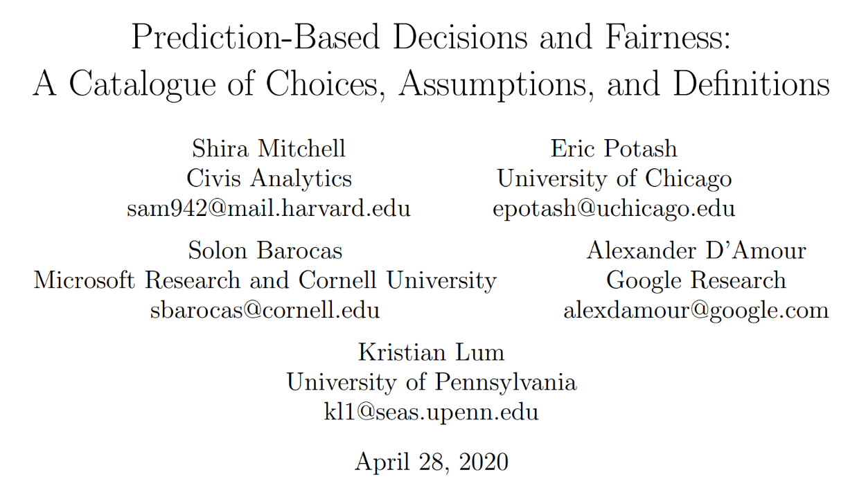
Learning More: Metrics
Notes:
Mitchell, Shira, Eric Potash, Solon Barocas, Alexander D’Amour, and Kristian Lum. 2018. “Prediction-Based Decisions and Fairness: A Catalogue of Choices, Assumptions, and Definitions.” arXiv [stat.AP]. arXiv. http://arxiv.org/abs/1811.07867.

Slide 46
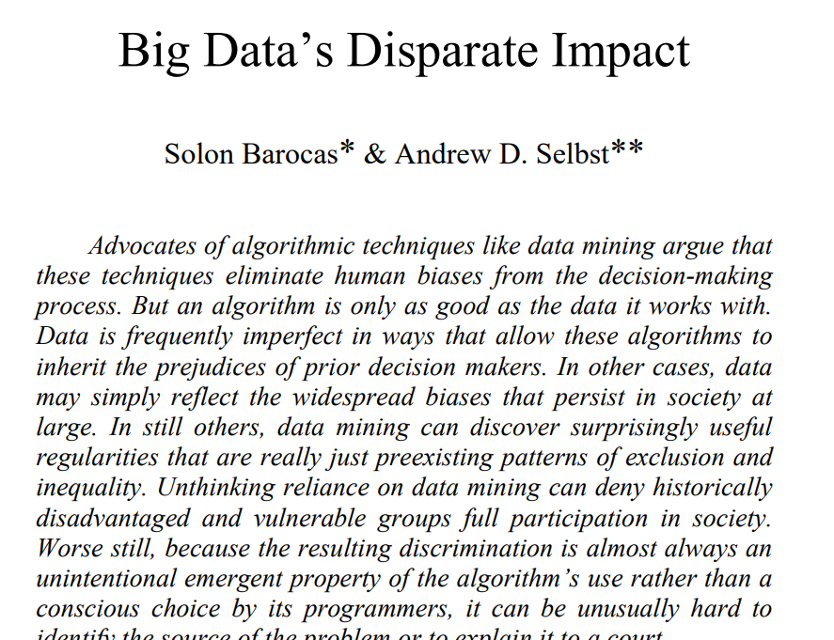
Learning More: Philosophy and Law
Notes:
Barocas, Solon, and Andrew D. Selbst. 2016. “Big Data’s Disparate Impact.” California Law Review 104 (3): 671. http://papers.ssrn.com/abstract=2477899

